Slide 1



A Slave to the Algorithms
On how revealing can ones Spotify
listening habits become
Baran Özcan
CS210 Term Project

Slide 2

Overview
1. Getting Inspired by a Problem, Devise a Hypothesis
2. Collecting Necessary Data
3. Exploring the Data (EDA)
4. Building Relevant Models
5. Assessment of the Hypotheses, Conclusion

Slide 3

THE INSPIRATION
AND THE PROBLEM
It all occurred to me while reading Yuval Noah Harari’s relavtively recent bestseller book “21 Lessons for 21st Century”.
Will algorithms and humans cahnge roles?
How sensetive my data is?
How much damage it can make ?
Shall i try it first?
2 Examples of the Harari

Slide 4


HERE ARE SOME HYPOTHESIS
H1: Mood descriptive features of my songs are dependt on the part of the day and the season that we are in
Corolary: The erengy of the song and the time determines the lenght that i listen to a song
H2: The weather, time and my general investment in one song, determines whether i skip a song or not

Slide 5

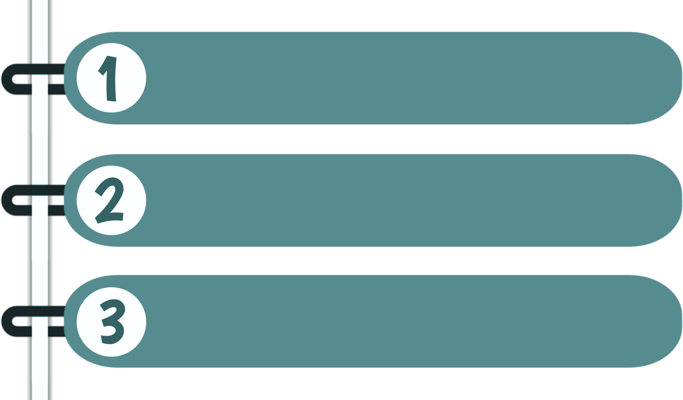

COLLECTING THE NECESSARY DATA
Request Detailed Listening History
Using Spotify API for song features

Slide 6

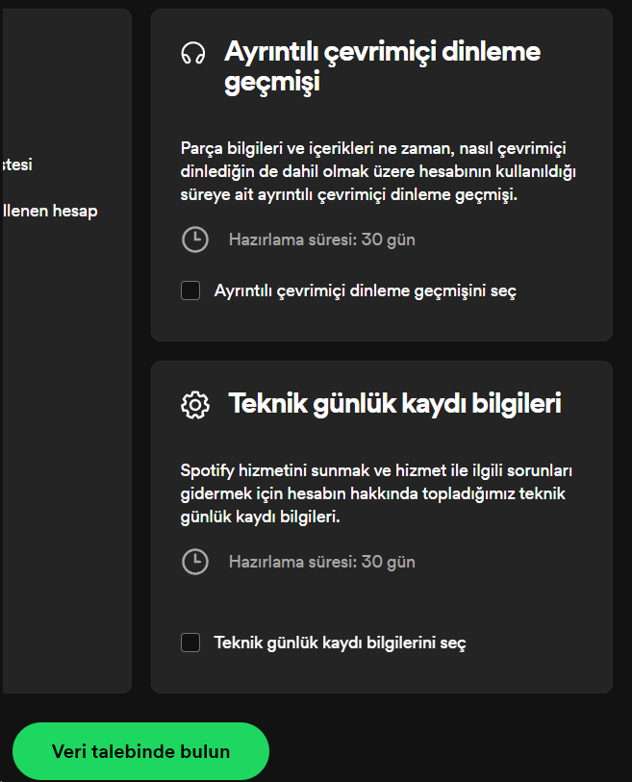
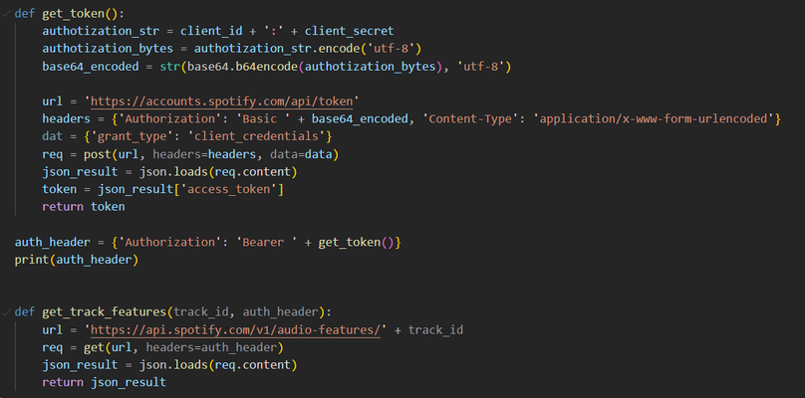
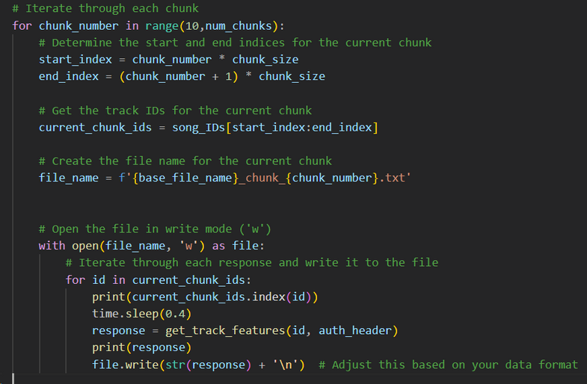

Slide 7

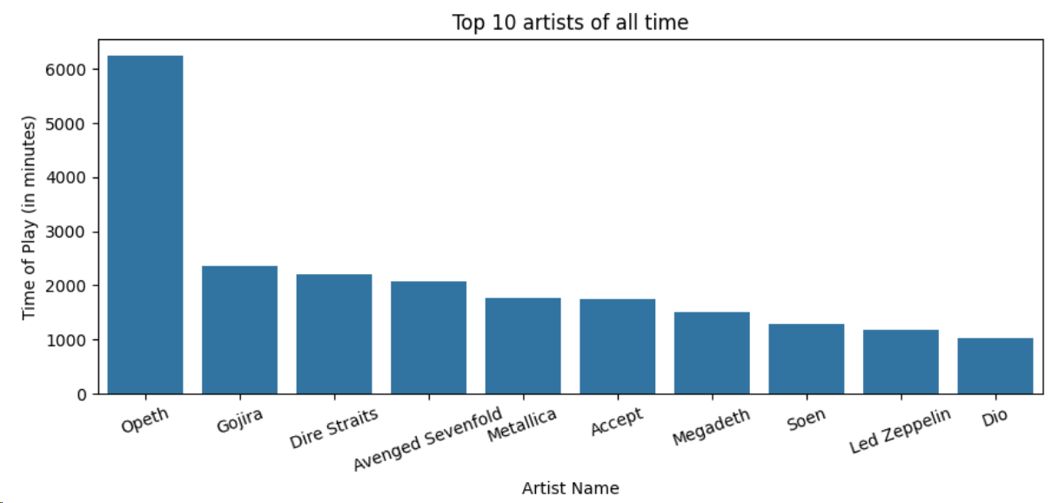

Some of the useless graphs can be reached through git repository/figures
EXPLORATORY DATA ANALYSIS

Slide 8
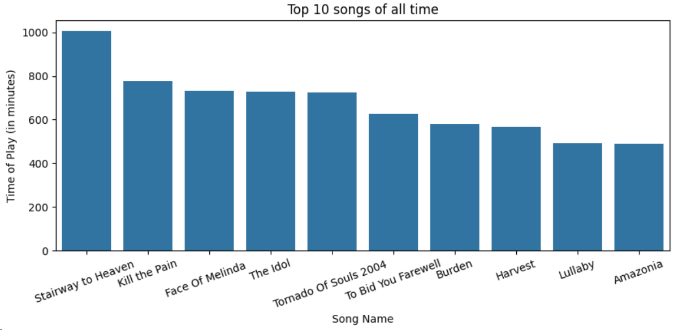
Some of the useless graphs can be reached through git repository/figures
EXPLORATORY DATA ANALYSIS

Slide 9
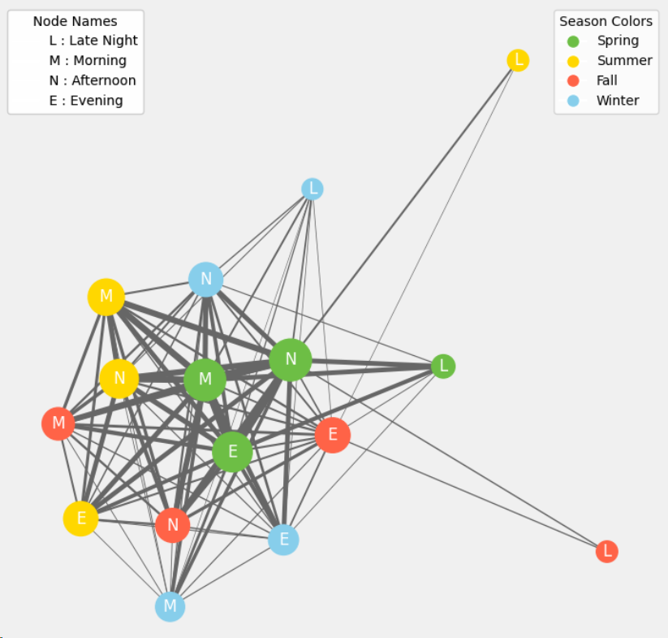

EXPLORATORY DATA ANALYSIS
Is this a network?

Slide 10
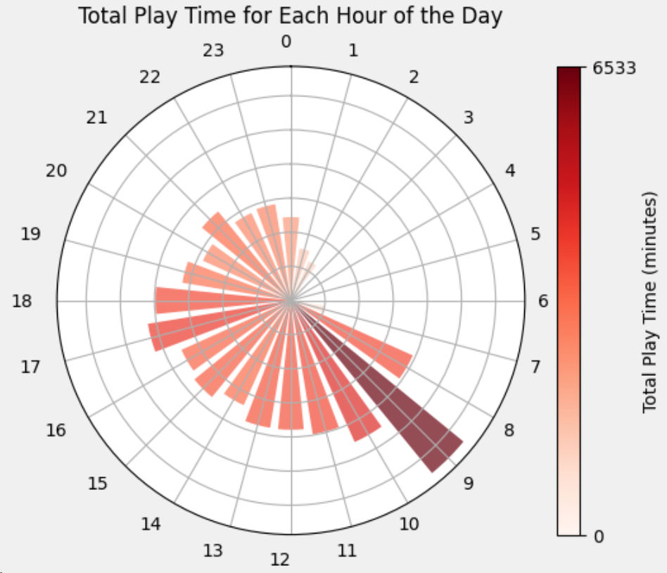
EXPLORATORY DATA ANALYSIS
Is this a clock?

Slide 11
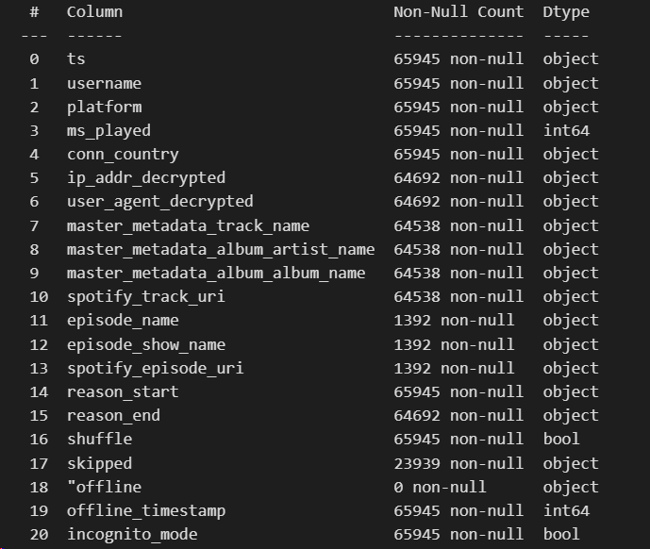
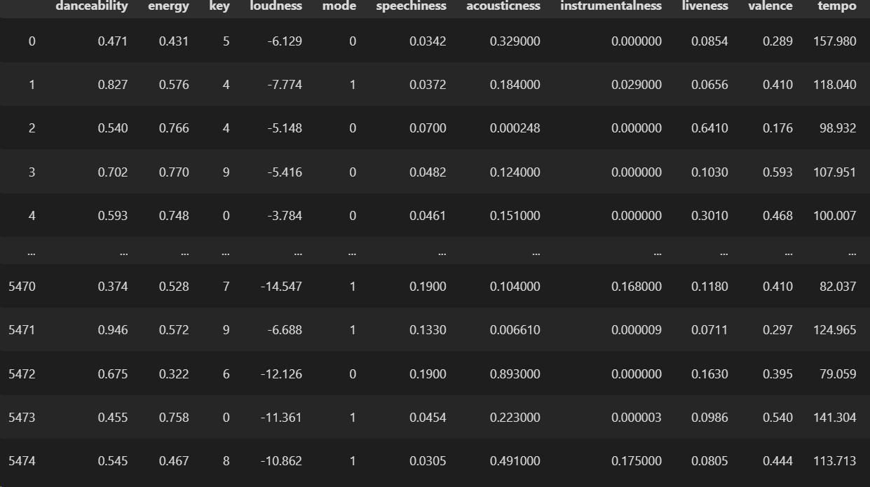
Some of the useless graphs can be reached through git repository/figures
EXPLORATORY DATA ANALYSIS

Slide 12
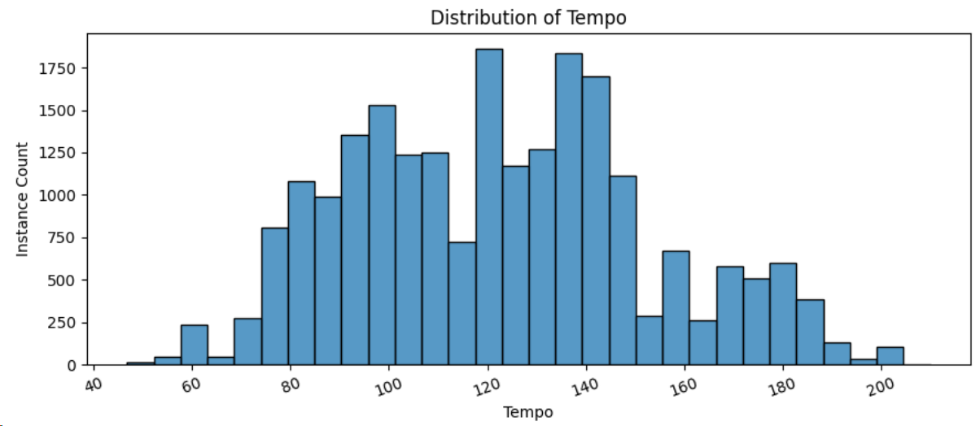
Some of the useless graphs can be reached through git repository/figures
EXPLORATORY DATA ANALYSIS
How is H1 doing

Slide 13

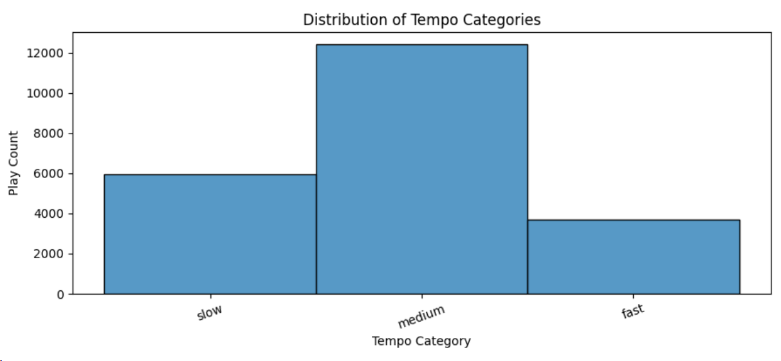
Some of the useless graphs can be reached through git repository/figures
EXPLORATORY DATA ANALYSIS

Slide 14
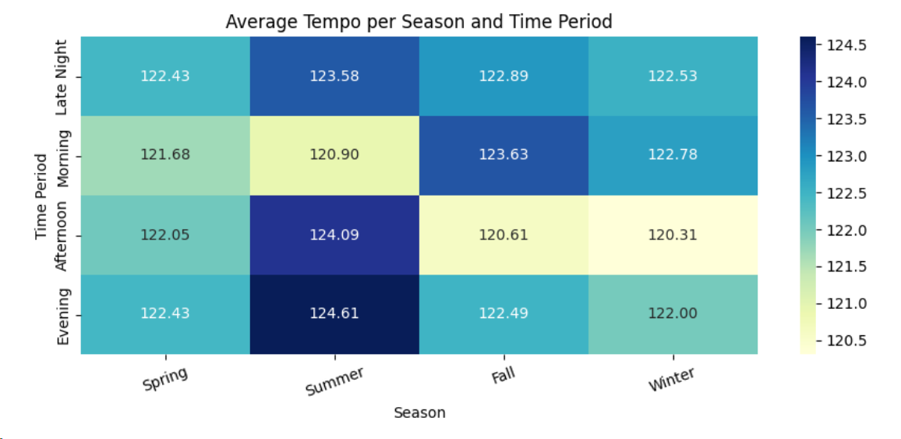
Some of the useless graphs can be reached through git repository/figures
EXPLORATORY DATA ANALYSIS
H1 fails?

Slide 15
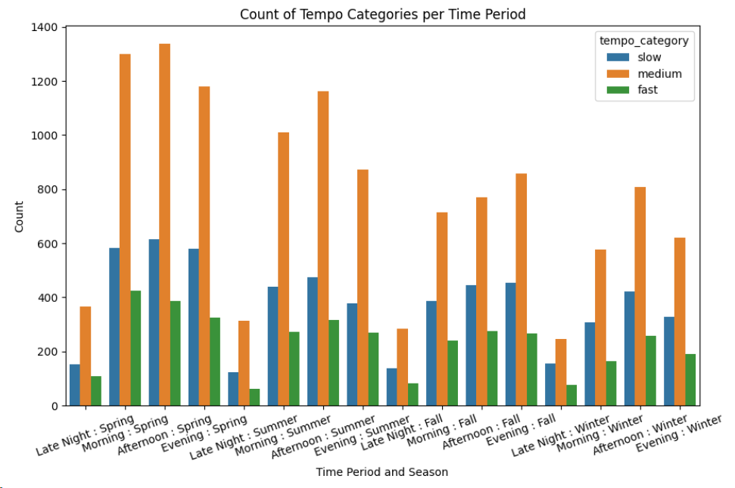
Some of the useless graphs can be reached through git repository/figures
EXPLORATORY DATA ANALYSIS
H1 fails?

Slide 16
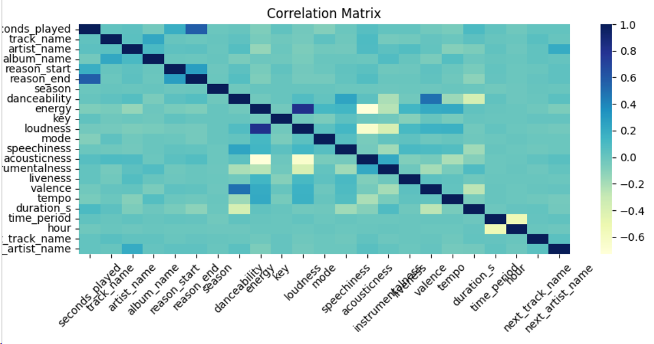
Some of the useless graphs can be reached through git repository/figures
EXPLORATORY DATA ANALYSIS
H1 fails?

Slide 17
Some of the useless graphs can be reached through git repository/figures
EXPLORATORY DATA ANALYSIS
Yes

Slide 18

Some of the useless graphs can be reached through git repository/figures
EXPLORATORY DATA ANALYSIS
Hopes about h2

Slide 19

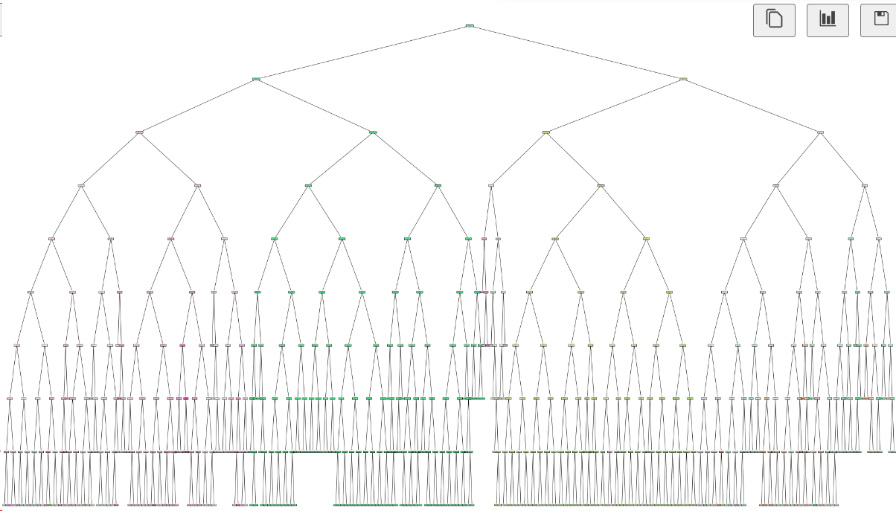
SUPERVISED LEARNING
H2 Holds?

Slide 20
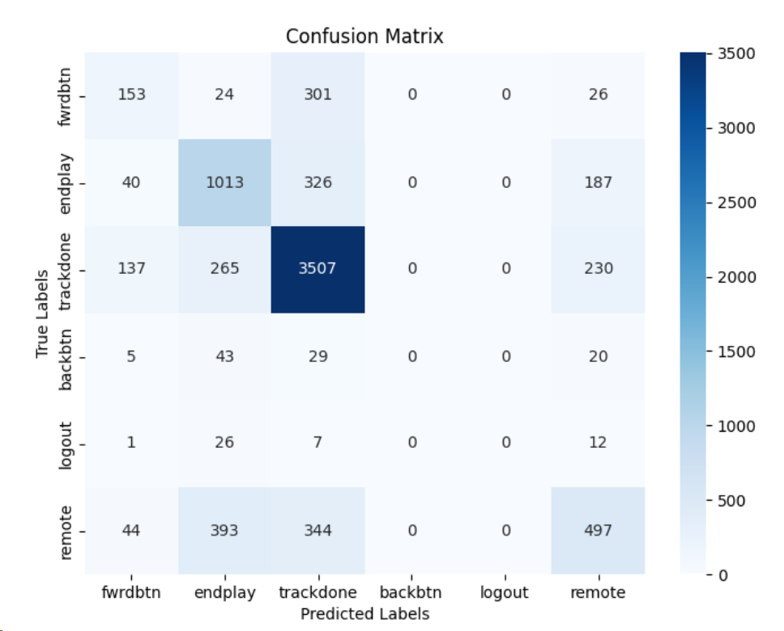
SUPERVISED LEARNING
H2 Holds?

Slide 21
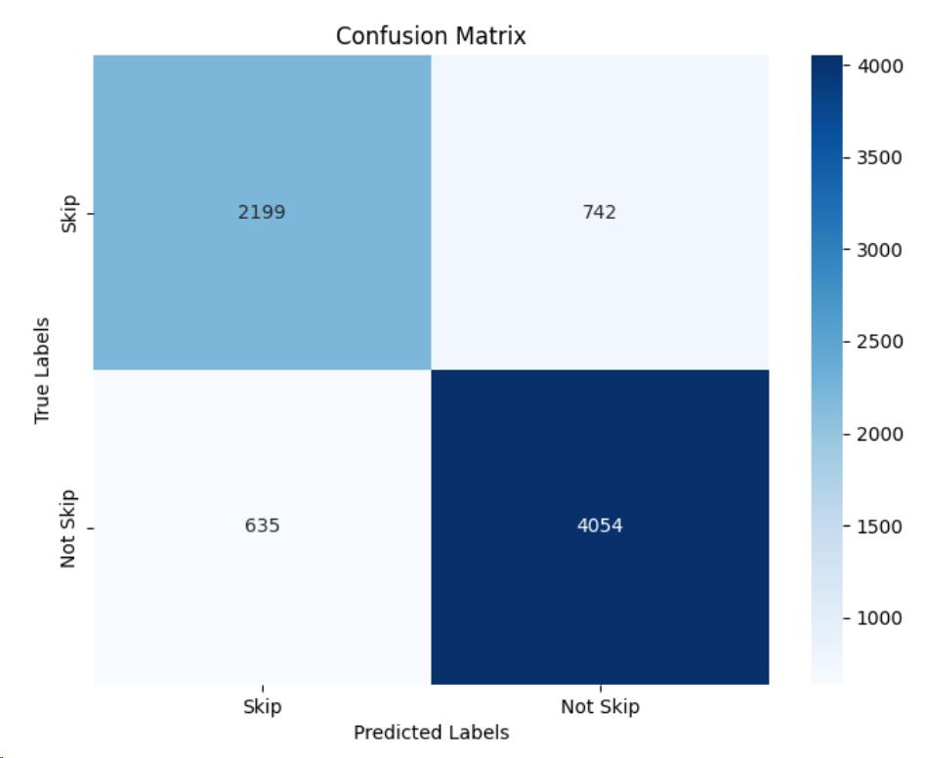
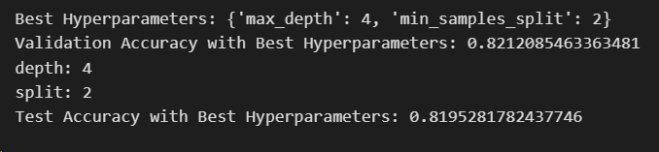
SUPERVISED LEARNING
With a better
feature
Engineering

Slide 22
SUPERVISED LEARNING
With a better
feature
Engineering

Slide 23

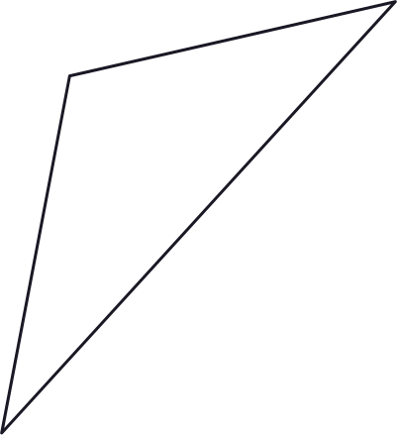
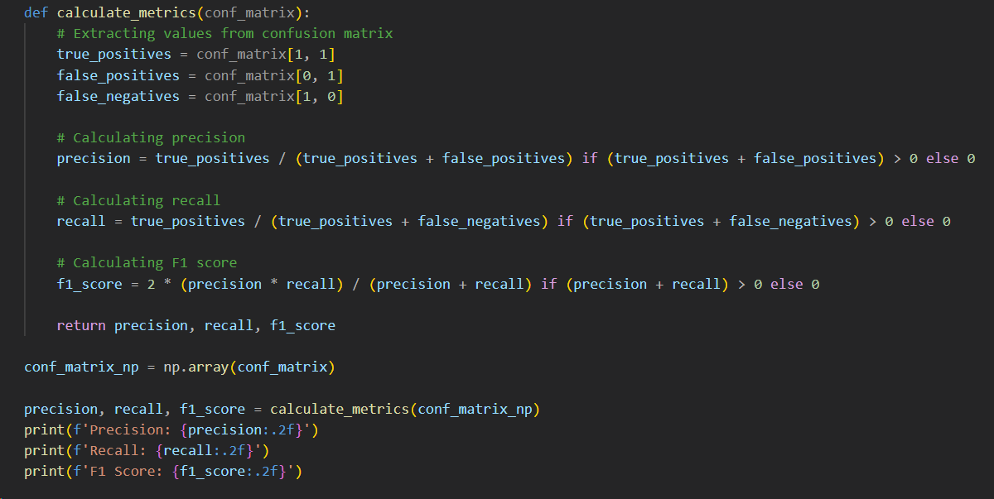
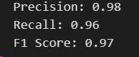
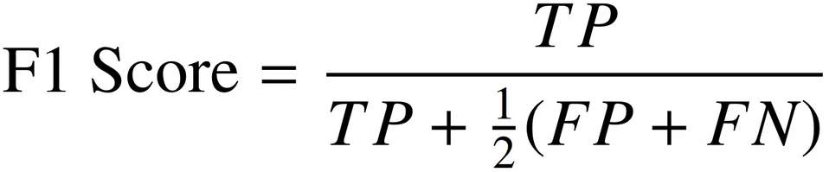
13
HYPOSHESIS TESTING

Slide 24

Ending Remarks
Thank you!
Baran Özcan
Corner of regrets:
Hypothesis testing could have done better
MORE interesting Graphs
Maybe using random forest instead of
Desicion tree?

